Slide 1
CEIS150 Module 5
Creating a Chart

Slide 2
Rubric
Activity | Requirement(s) | Points
Chart | Screen shot of working Chart | 40

Slide 3
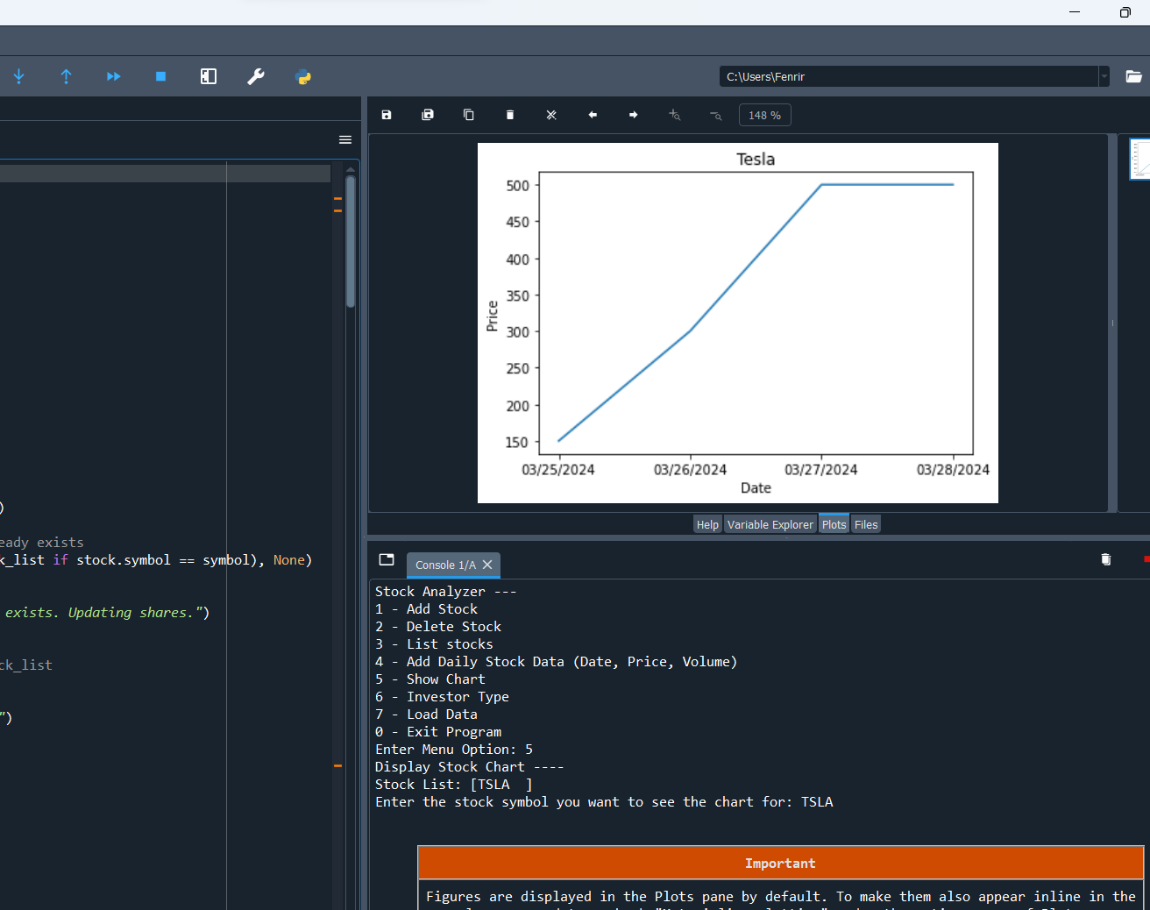
Chart
Paste a screen shot of your stock chart.

